Slide 1

Charlotte Hornets Group Project
Bryce Rummel, Chris Saacks, Joshua McDonald, and Jaren Robbins

Slide 2
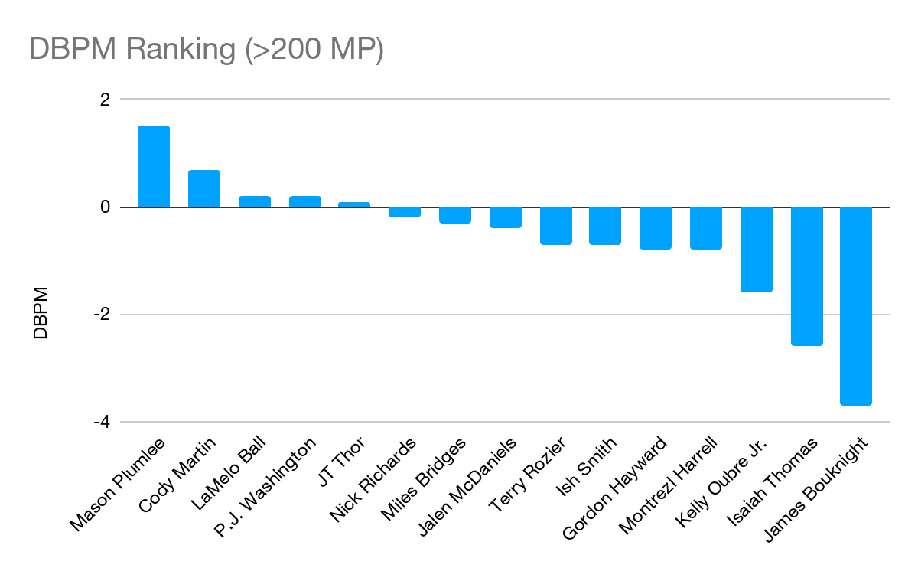
Team Needs
At first glance: a shiny new Center
Interior defense
Shot blocking
However, this is not the biggest need
Opponents shot 62.6% on shots less than 5 ft - ranked 10th overall
Plumlee - team’s best defensive rating (players averaging >20 mins)
Defensive Box Plus/Minus
A box score estimate of the defensive points per 100 possessions a player contributed above a league-average player, translated to an average team.
Notes:
Jaren

Slide 3
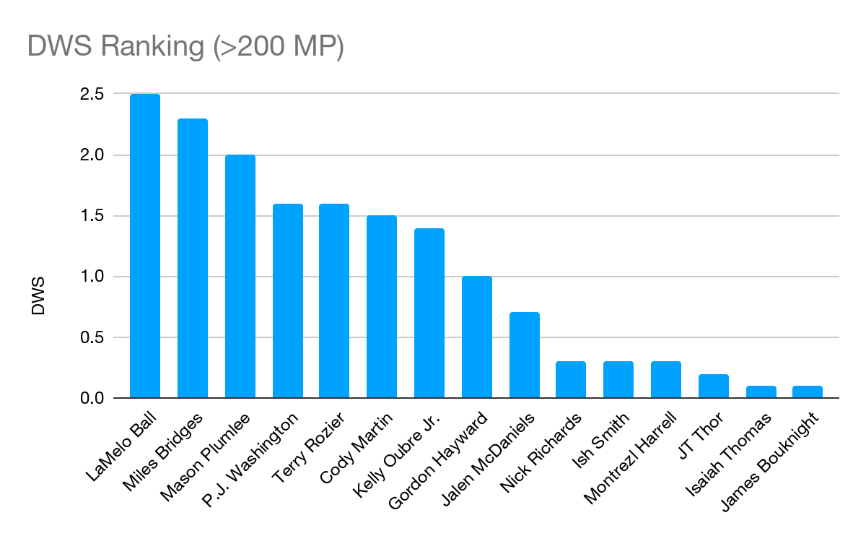
Perimeter Defense
Opponents shot 36.2% from shots from 25 to 29 ft
Ranked 28th in the league
Contested 48.4% of all opponent’s shots
Tied for 23rd in the league
Players need to close down shots more aggressively
Cleaner rotations
Defensive Win Shares
An estimate of the number of wins contributed by a player due to defense.
Notes:
Jaren

Slide 4
Former players drafted at Pick 13:
Tyler Herro - Miami Heat
Donovan Mitchell - Utah Jazz
Devin Booker - Phoenix Suns
Zach Lavine - Minnesota Timberwolves
Kobe Bryant - Charlotte Hornets (traded to the LA Lakers)
Jalen Rose - Denver Nuggets
Karl Malone - Utah Jazz
Mitch Kupchak (current GM of the Charlotte Hornets) - Washington Bullets
With the 13th pick in the 2022 NBA Draft, the Charlotte Hornets select…
Notes:
Jaren

Slide 5
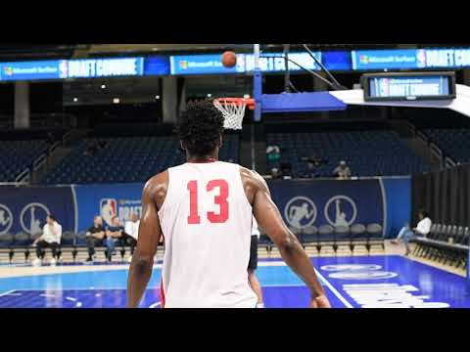

Slide 6

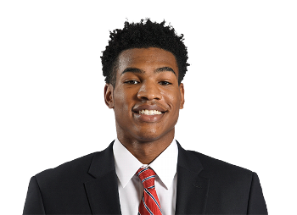
Ochai Agbaji (SG) - Kansas
6’6”, 215 lbs, 22 years old
Sturdy frame and 6’10” wingspan give this player amazing defensive potential
Quick release shot
Explosive athlete that can run in transition and be a lob threat.
Lateral quickness and wingspan can make him a defensive disruption from the start
He ranked 23rd in the country in 3 PT% (41), and he took the third most attempts (252) out of those 23 players. He also shot 42% on catch-and-shoot jumpers, which placed in the 89th percentile.
AWARDS AND ACCOLADES: Honorable Mention All-Big 12 (2020), First-Team All-Big 12 (2022), Big 12 Player of the Year (2022), Consensus First-Team All-American (2022), NCAA Final Four Most Outstanding Player (2022), and NCAA champion (2022)
Played all 4 years in college. Mature and ready to play in the NBA right now.
Can be a very good defender, slasher, and spot up wing.
Notes:
Christopher

Slide 7
Weaknesses
Poor ball handler - when trying to drive often settled for floaters. However, was in the 6th percentile for floaters.
Doesn’t create much off of the dribble. He isn’t a creative ball handler or isolation offensive player.
He doesn’t create shots for himself. More involved in catch and shoot, pin downs, coming off a screen, or quick off the dribble shots.
Notes:
Christopher

Slide 8
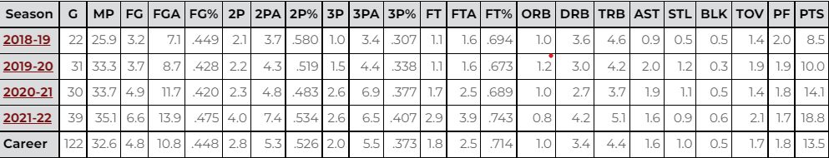
Statistics
3P% : 40.7% (Senior Year) 37.3 % (Career)
eFG% : 57%
TS%: 60%
Has grown in almost every category
Averaging ~ 2 STL + BLK
1.9 fouls per game
FT%: 71.4 FTA: 3.9(Senior Year) 2.5 (Career) FT rate -.28 (FTA/FGA)
AST to TOV ratio 2.0/2.1
AST%/Usage%: 8.7%/25.3%
Notes:
Christopher

Slide 9
Comparable Players
Other 3 and D wings around the league:
Cam Johnson
Andrew Wiggins
Mikal Bridges
Jerami Grant
Og Anunoby
Trevor Ariza
Robert Covington
Danny Green
Wesley Matthews
Specific to Ochai:
Desmond Bane
OG Anunoby
Jae Crowder
Notes:
Christopher

Slide 10
Former 13 picks Comparisons
Ochai Agbaji
Donovan Mitchell
Devin Booker
Markieff Morris
Notes:
Bryce

Slide 11
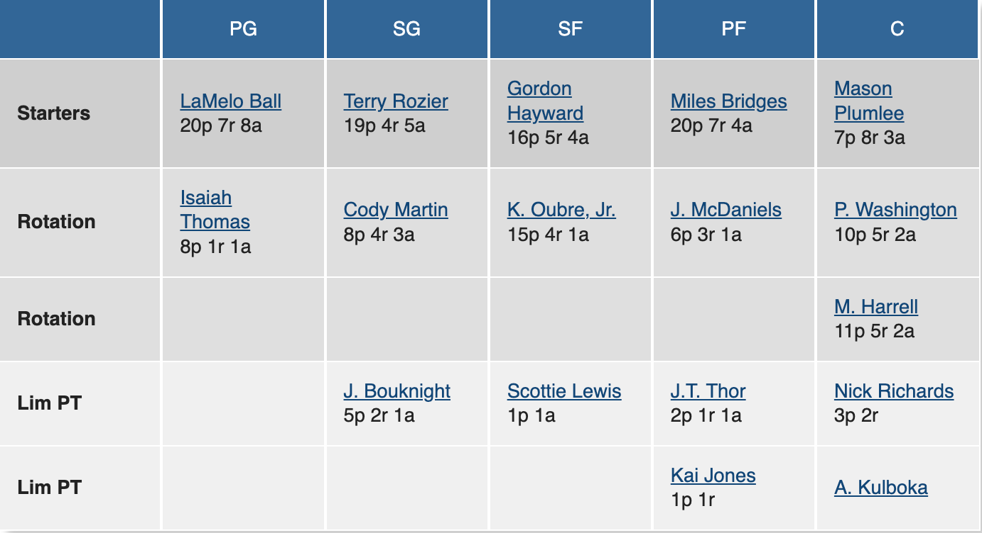
2021-2022 Charlotte Hornets Depth Chart
Notes:
Jaren

Slide 12
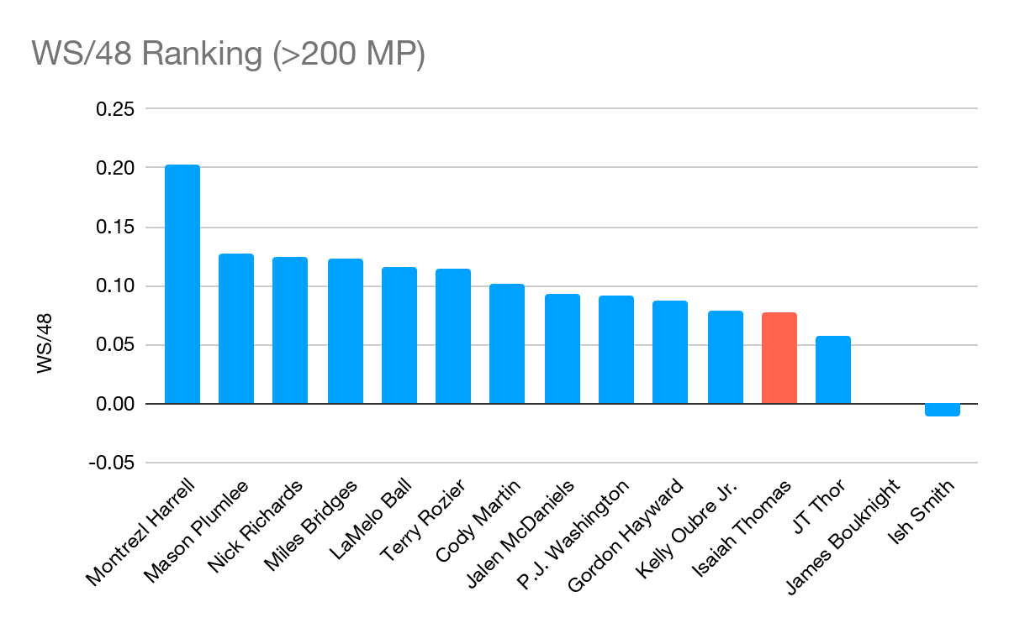
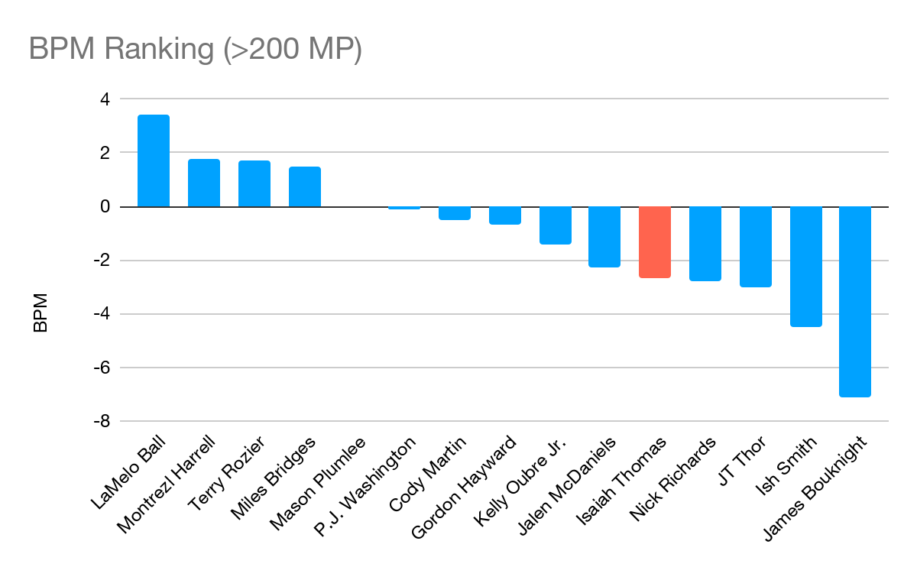
The Isaiah Thomas Problem
Win Shares Per 48 Minutes
An estimate of the number of wins contributed by a player per 48 minutes (league average is approximately .100)
Box Plus/Minus
A box score estimate of the points per 100 possessions a player contributed above a league-average player, translated to an average team.
Notes:
Jaren

Slide 13
With the 15th pick in the 2022 NBA Draft, the Charlotte Hornets select…
Former players drafted at Pick 15:
Kelly Oubre (on Hornets roster currently) - Atlanta Hawks (traded to the Washington Wizards)
Giannis Antetokounmpo - Milwaukee Bucks
Kawhi Leonard - Indiana Pacers (traded to San Antonio Spurs)
Steve Nash - Phoenix Suns
Dell Curry - Utah Jazz (10 seasons with Charlotte Hornets)
Notes:
Josh

Slide 14
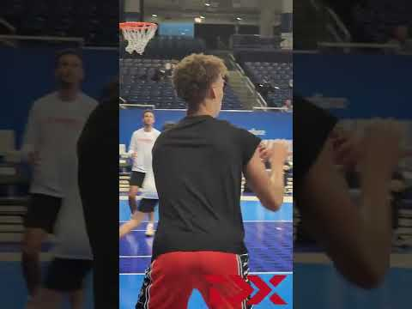

Slide 15
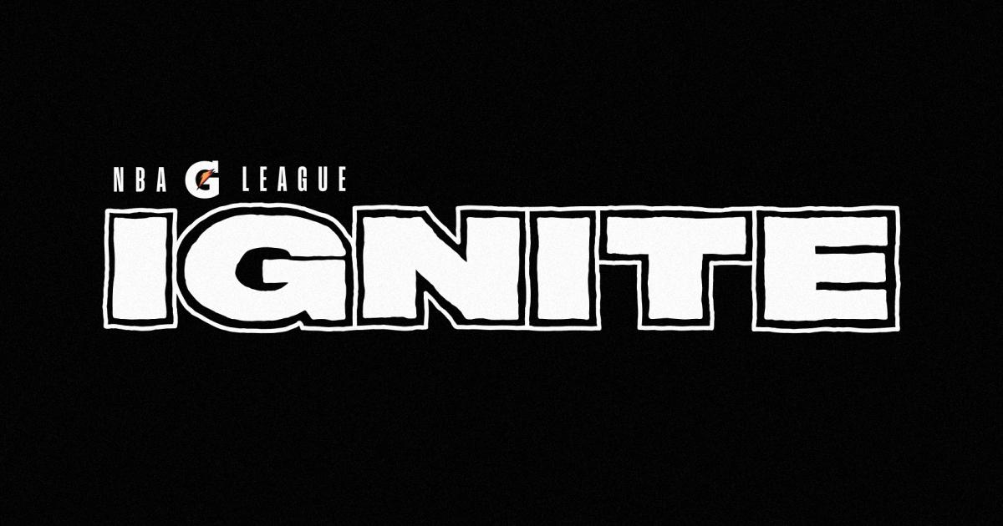
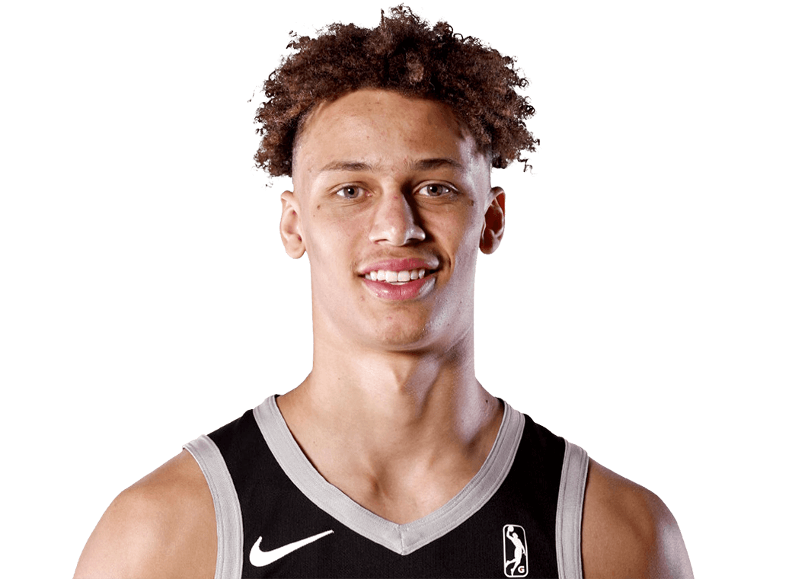
Dyson Daniels (G) - G-League Ignite
6’7”, 200 lbs, 19 years-old. From Australia
Incubated by the G-League in order to come out a much more powerful player.
Analytically defensive player with great improvisational skills. Quick-witted
Allows this player to make plays coming off sharp angles.
Ignite players in the league (Jalen Green, Jonathan Kuminga)
Fantastic defensive player
Especially against other guards and wings
Big, versatile ball handler
Unselfish, natural passer and good court vision
Attacks the boards
Active hands (lots of steals)
Good game manager - moves the ball and connects well with teammates
Notes:
Josh

Slide 16
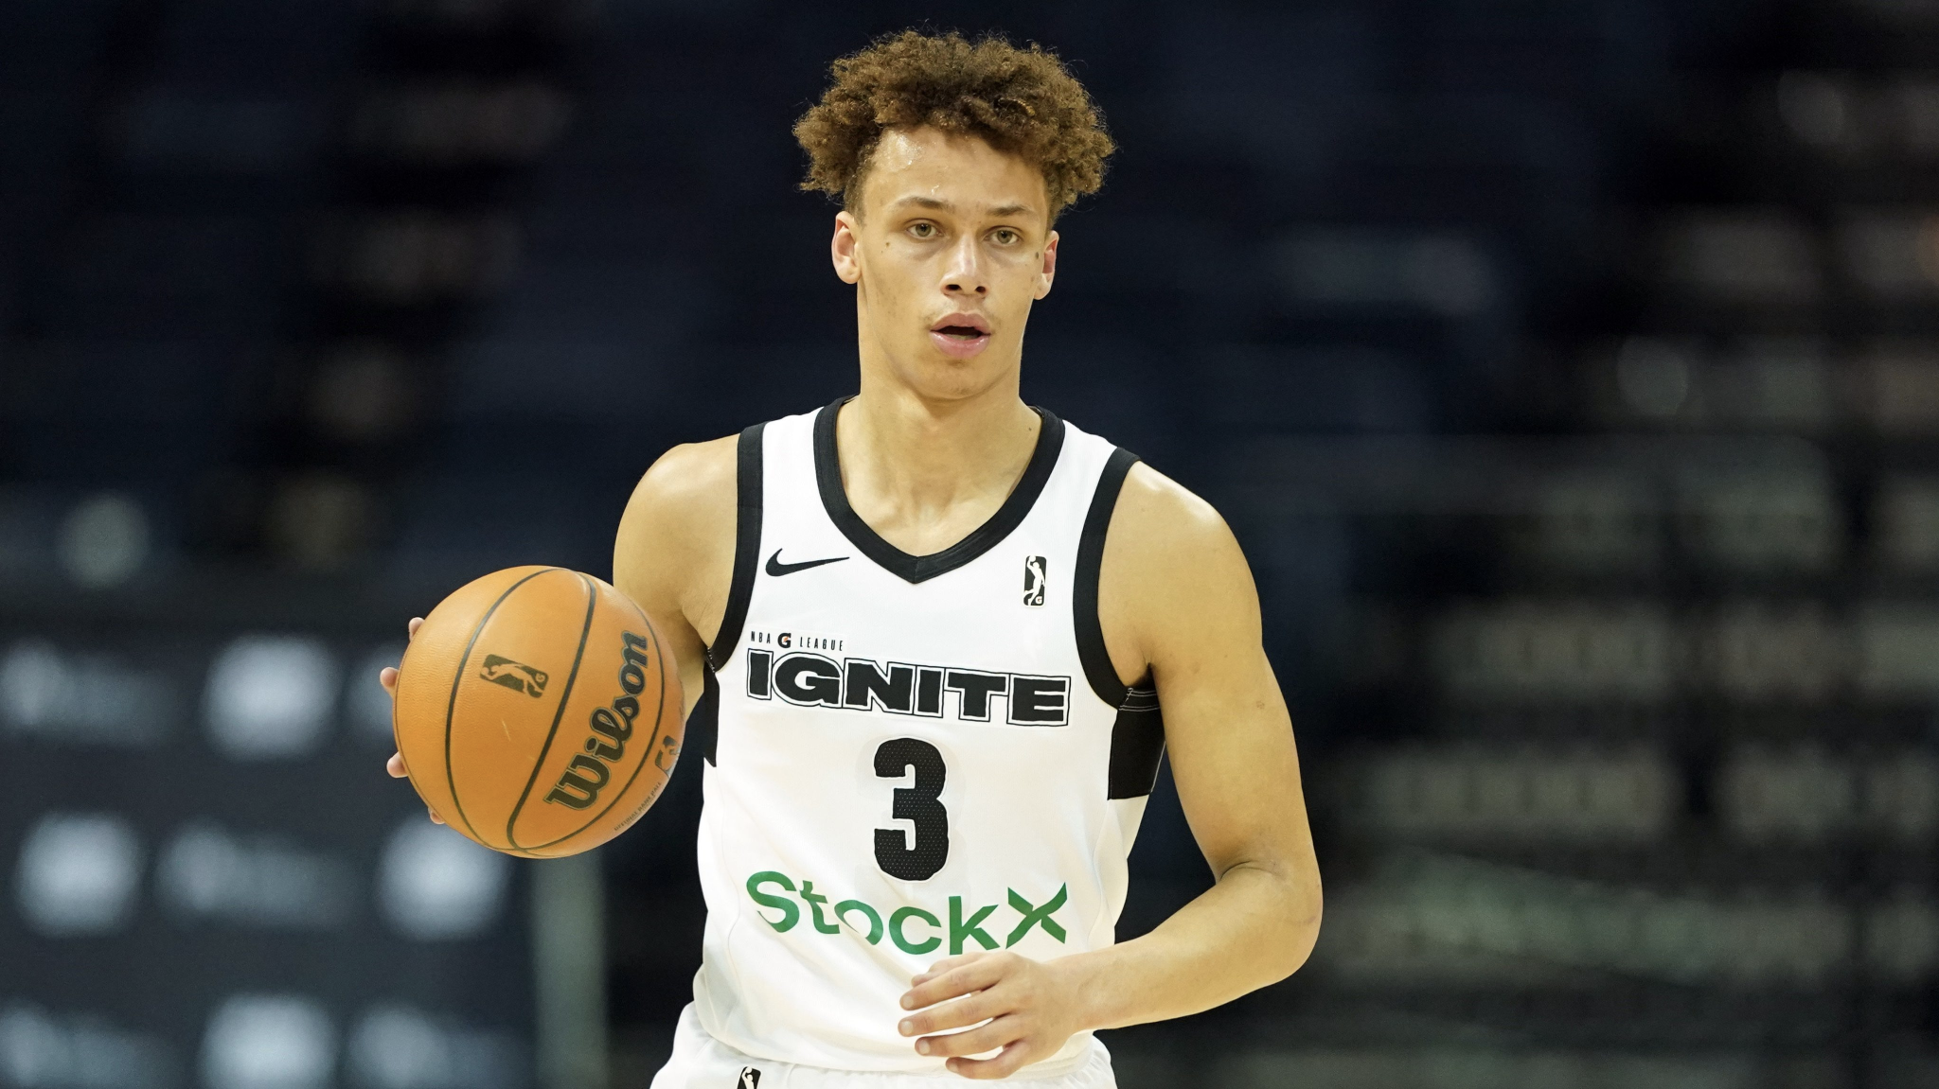
Weaknesses
More shot practice is required (FTs and 3Ps) (Inconsistent shooter)
3P% - 29.9%
FT% - 53.3%
Lackluster handles. With time and practice, can be amazing
Could be more explosive
Makes attempting layups much more difficult
Rarely gets to the FT line
Often is too unselfish and passes up layups
Notes:
Josh

Slide 17
Statistics
Small sample size - 14 games
2 STL per game
.7 BLK per game as a PG
Only 2.1 fouls per game
6.2 RPG, would be 5th in the NBA for PG’s (behind LaMelo Ball)
Only 1.4 FTA per game(FT/FGA - .14)
25.5% 3PT
HOB (hands on buckets) FG + Assists/ Team FG - .222
Notes:
Bryce

Slide 18
How would he fit with the Hornets?
He can be a contributor and productive guard coming off of the bench.
Daniels’ size would allow the team to have a “small ball” approach during certain parts of the game.
A real world example of a 3 guard lineup -
2020 OKC Thunder. Had a lineup of Chris Paul, Shai Gilgeous-Alexander, and Dennis Schröder. Schröder off of the bench.
Similarly, Hornets can run a lineup with LaMelo Ball, Terry Rozier, and Dyson Daniels. Both LaMelo Ball and Dyson Daniels have the size to make this even more effective.
Notes:
Bryce

Slide 19
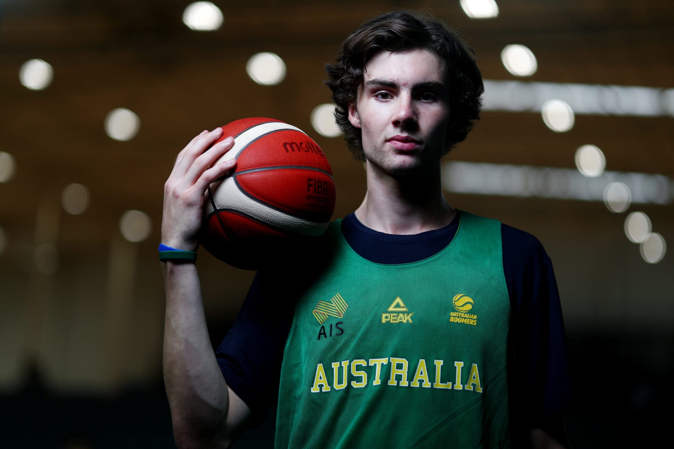
Comparable Players:
No perfect comparisons, however here are some similar players.
Derrick White
Kyle Anderson
Evan Turner
Dejounte Murray
Josh Giddey
Lonzo Ball
Notes:
Bryce

Slide 20
Other Options in the draft
Mark Williams (C) - Duke
Strengths - shot blocking, off-ball defense, interior scoring, rebounding
Weaknesses - lateral quickness, playmaking
Hassan Whiteside, Robert Williams
9.7 PPG, 2.3 BPG, 6.3 REB
Malaki Branham (SG/SF) - Ohio St.
Strengths - perimeter shooting, on-ball defense
Weaknesses - playmaking, passing
Khris Middleton, Caris Levert
13.7 PPG, 49.8 FG%, 41.6 3PT%
Jeremy Sochan (PF) - Baylor
Strengths - on-ball defense, off-ball defense, feel for the game, playmaking
Weaknesses - shooting, post-up game
Ben Simmons, Draymond Green, Aaron Gordon
9.2 PPG, 1.3 SPG, .7 BPG
Notes:
Bryce

Slide 21
New Depth Chart
 | PG | SG | SF | PF | C
Starters | LaMelo Ball | Terry Rozier | Gordon Hayward | Miles Bridges | Mason Plumlee
Rotation | Dyson Daniels | Ochai Agbaji | Kelly Oubre, Jr. | PJ Washington | Montrezl Harrell
James Bouknight | Cody Martin | Jalen McDaniels
Notes:
Bryce

Slide 22
Sources
https://www.atthehive.com/2022/5/30/23146034/advanced-stats-class-the-hornets-defensive-rating-was-the-teams-downfall
https://www.basketball-reference.com/teams/CHO/2022.html
https://nbadraft.theringer.com/mock-draft
https://basketball.realgm.com/nba/teams/Charlotte-Hornets/3/depth-charts
https://www.nbadraft.net/players/ochai-agbaji/#per-game
https://www.grizzlybearblues.com/2022/6/1/23148898/2022-nba-draft-prospect-profiles-ochai-agbaji-memphis-grizzlies-kansas-jayhawks
Notes:
anyone

